Slide 1


SATELLITE SERVICE ELIGIBILITY CHECKER
Machine Learning Model for Customer Eligibility Assessment
GROUP D
Christian, Mokgadi, Delight, Omphile

Slide 2

Project Overview
Objective: To develop a predictive model to check customer eligibility for a satellite service based on specific financial and residential criteria.
Method: Using a Shiny app interface to gather input and display results, while employing a Random Forest model for classification.

Slide 3
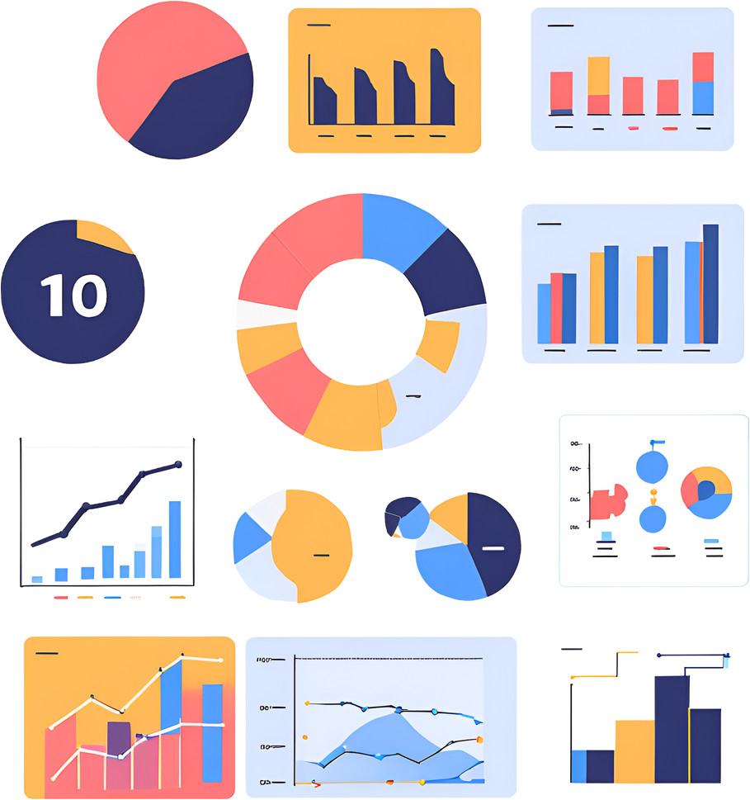
Data and Thresholds
Dataset: Cleaned data with relevant features, loaded from a CSV file.
Key Thresholds:
Annual Salary ≥ $50,000
Year-to-Date Gross Income ≥ $45,000
Years of Residence ≥ 2.5
Eligibility Decision: Customers meeting all thresholds are classified as "Eligible."

Slide 4
Random Forest Model Overview
Model Selection: Random Forest, chosen for its robustness and ability to handle complex datasets with multiple variables.
Features Used:
Annual Salary
Gross Year-to-Date Income
Years of Residence
Training: Model was trained with 5-fold cross-validation to improve accuracy and prevent overfitting.

Slide 5
Model Training and Validation
Data Split: 80/20 split for training and testing datasets.
Cross-Validation: 5-fold cross-validation applied to the training set.
Hyperparameters:
Number of Trees (ntree): 10 (chosen for efficiency during testing).

Slide 6
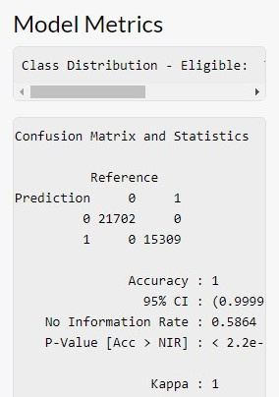
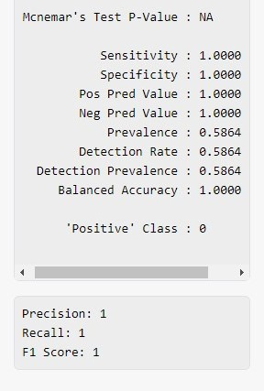
Model Metrics
These metrics help us assess how well the model identifies eligible customers and avoids misclassifications.

Slide 7
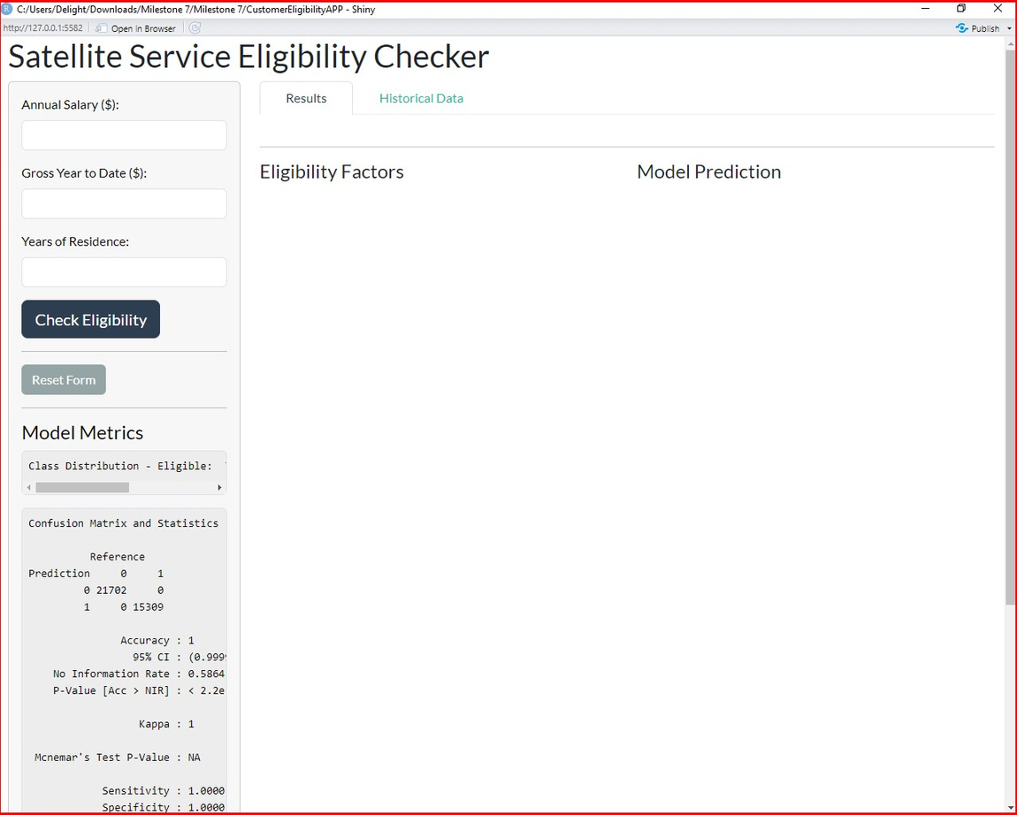
Shiny App UI - User Interaction
Inputs
Buttons
Outputs

Slide 8
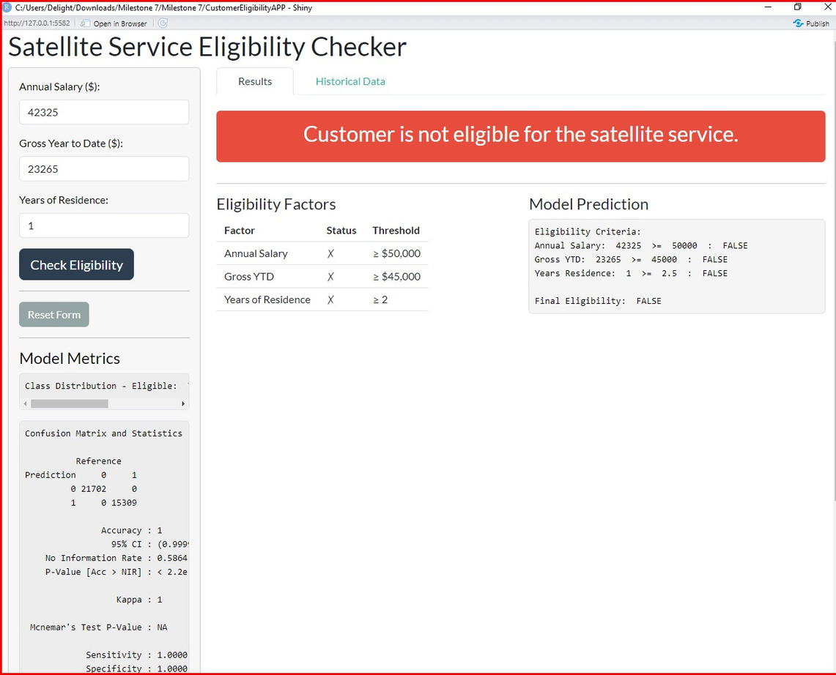
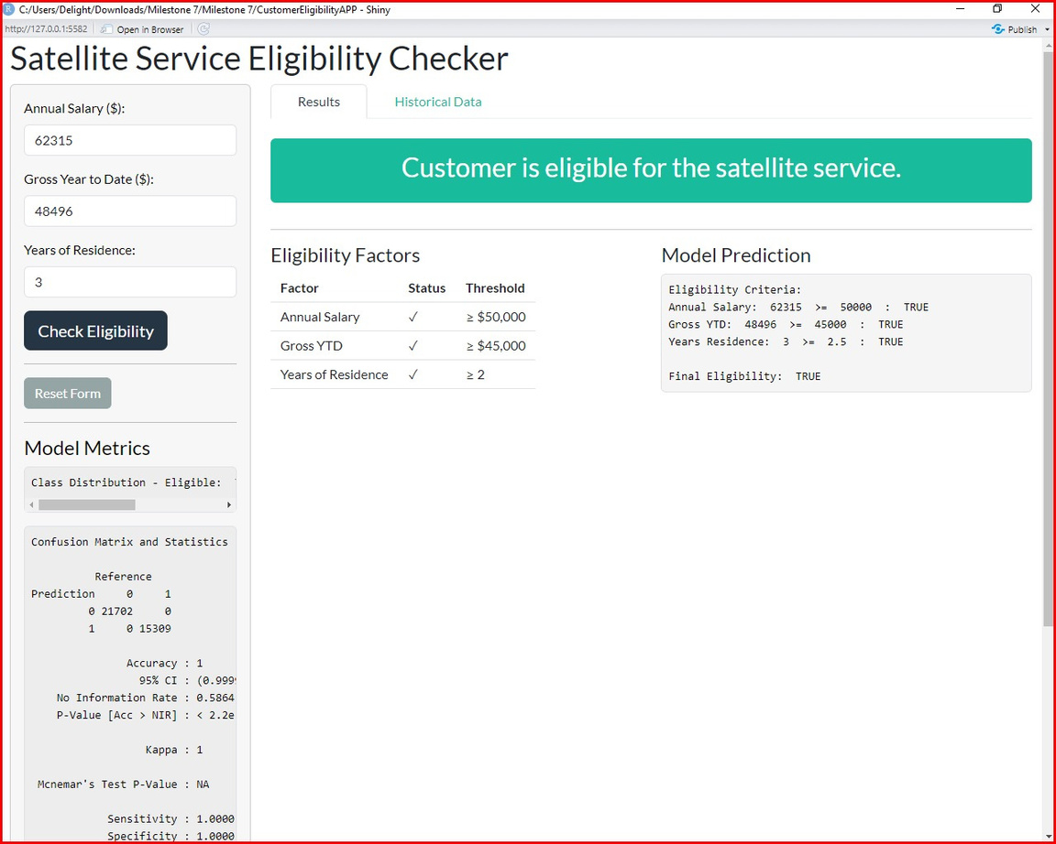
Shiny App UI - User Interaction(continued)
Displays whether the customer meets all eligibility requirements.
Logs previous predictions for user reference.
Shows each factor and if it meets the required threshold.

Slide 9
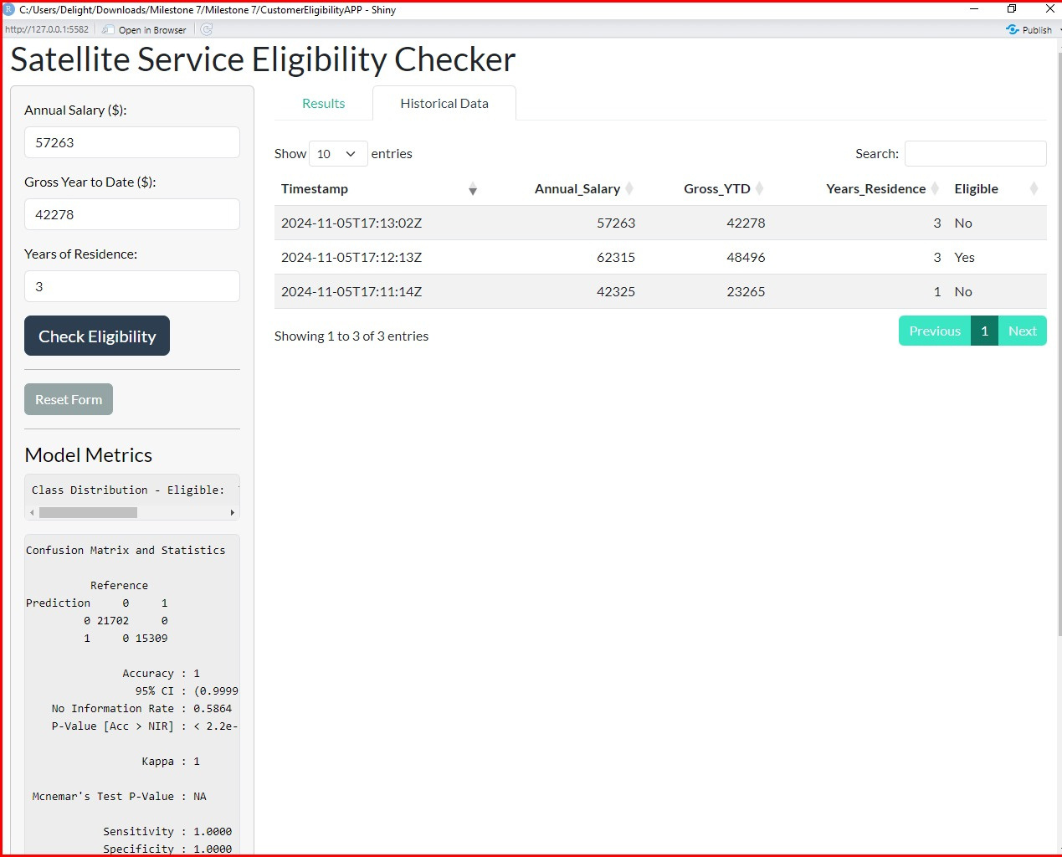
Shiny App UI - User Interaction(continued)
Based on thresholds; each criterion (Salary, YTD, Residence) is checked individually.
Random Forest model makes the final prediction using all three criteria.

Slide 10
Conclusion and Future Work
This application streamlines eligibility assessment using an intuitive interface and a robust Random Forest model.
Potential Improvements:
Model Tuning: Increase tree depth and number for potentially higher accuracy.
User Experience Enhancements: Add feedback loops based on user input and performance.
Additional Features: Incorporate more features, such as credit score, for improved prediction accuracy.

